Slide 1

Presentation
Bank Data Analysis for Loan Approval

Slide 2

Objective
To Find out customers whose loan application can be accepted after analysis of the Dataset

Slide 3
Steps Involved
Reading of data
Cleaning of Data
Univariate, Bivariate and Multivariate Analysis
Plotting of different graphs
Filtering of Data
Exporting the Data
Problem Understanding

Slide 4
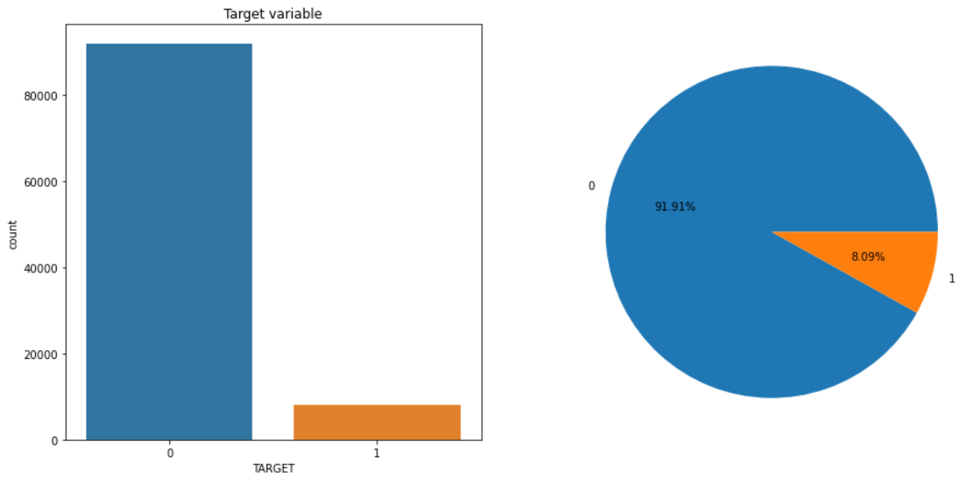
Analysis of Dataset
There are about 8.09 % of Defaulters in the dataset

Slide 5
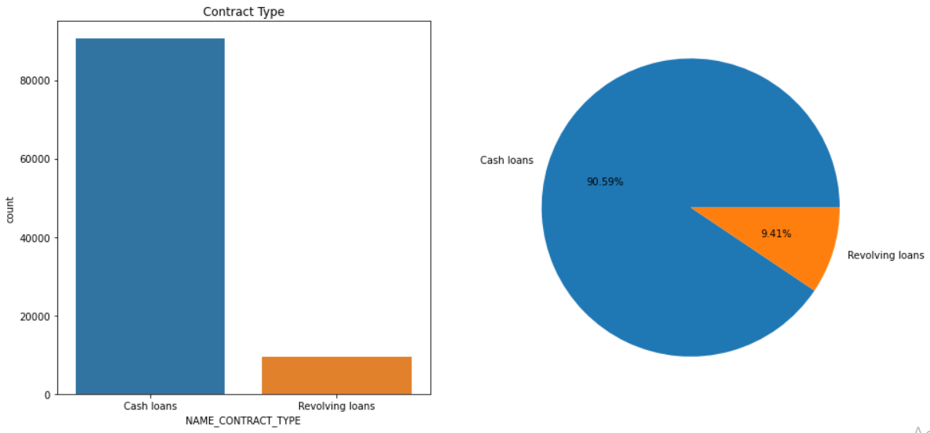
Types of Loans offered

Slide 6
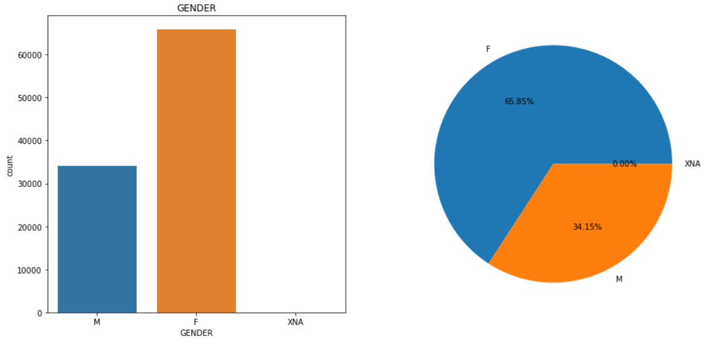
Gender wise Loan Distribution
Female Loan Applicants are more as compared to male applicants

Slide 7
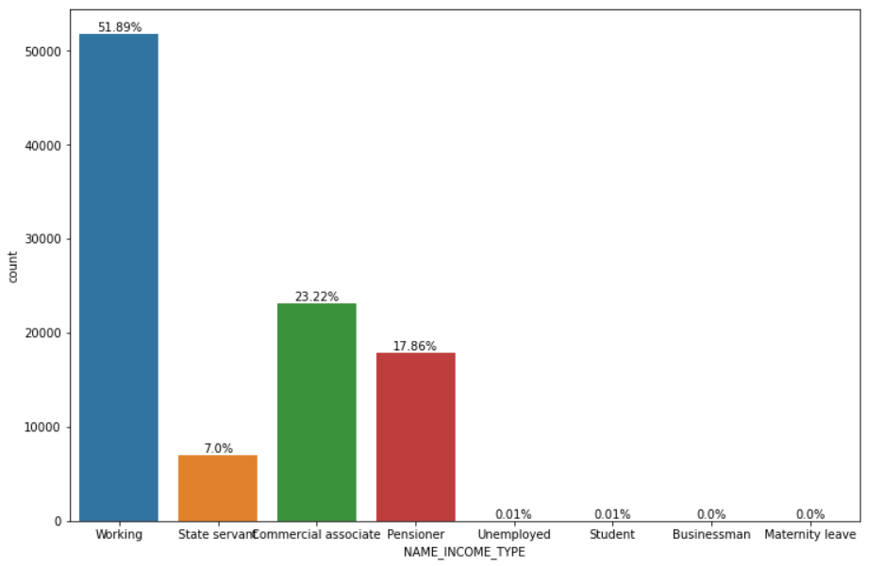
Income type distribution

Slide 8
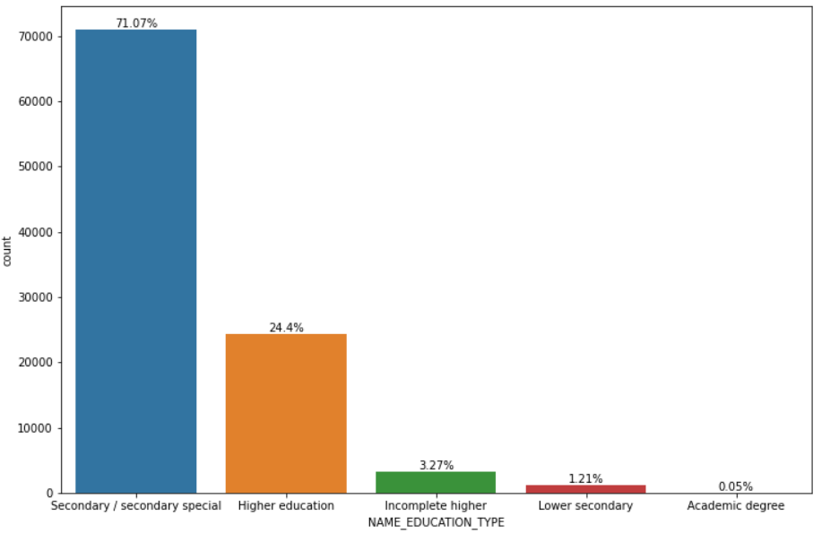
Education Type Distribution

Slide 9
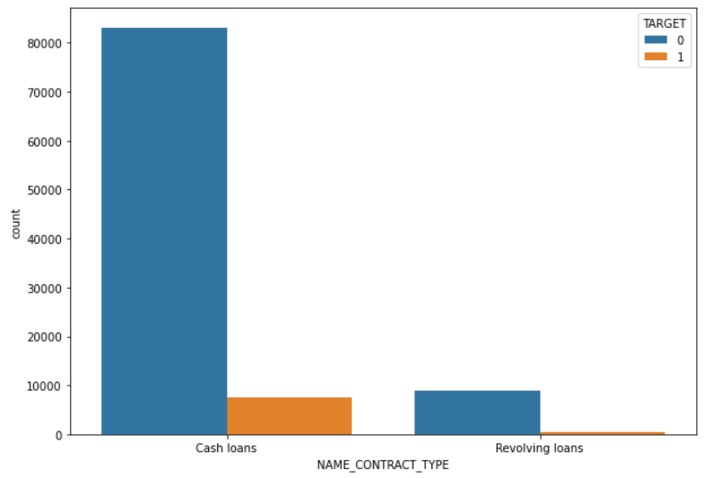
Loan type w.r.t Target

Slide 10
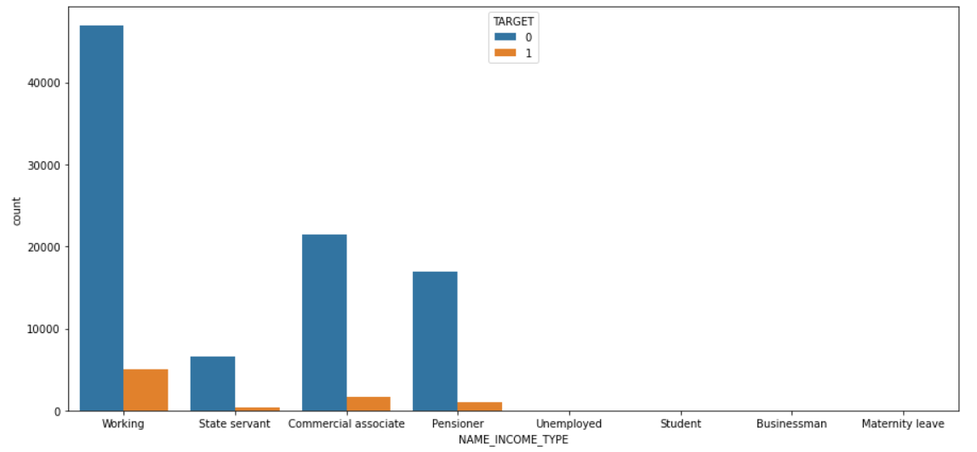
Income type distribution w.r.t Target

Slide 11
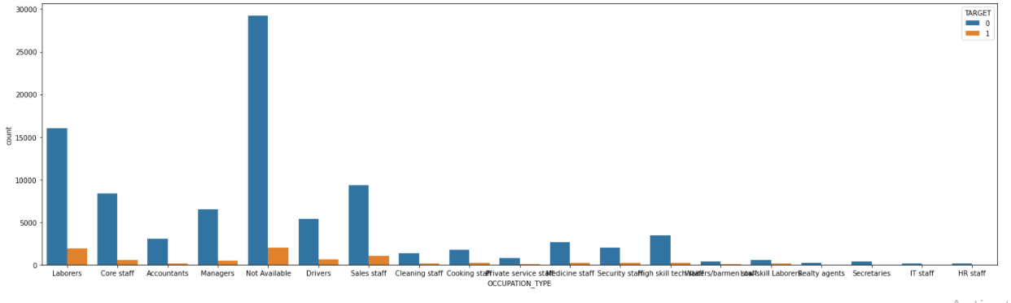
Occupation Type analysis w.r.t Target

Slide 12
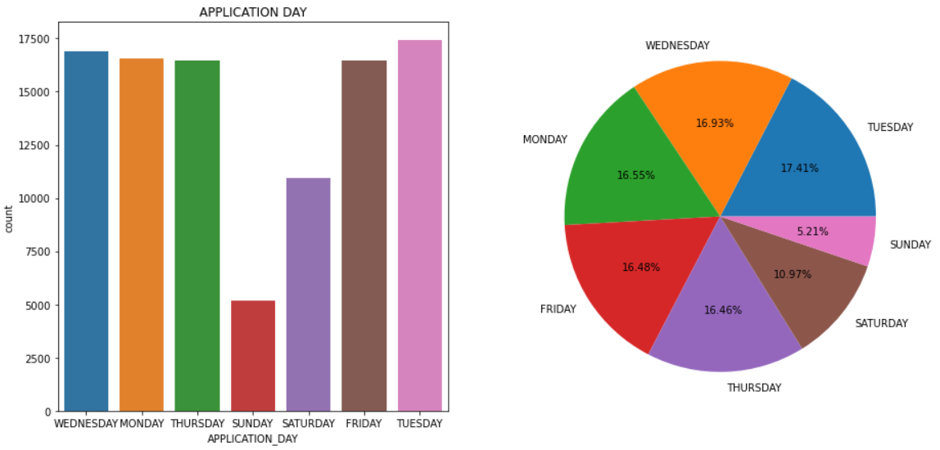
Days Of Application
Tuesday is the busiest day of week

Slide 13
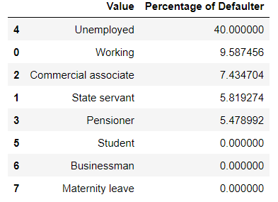
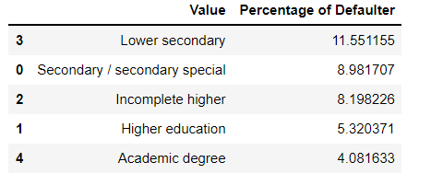
Finding the percentage of Defaulters

Slide 14
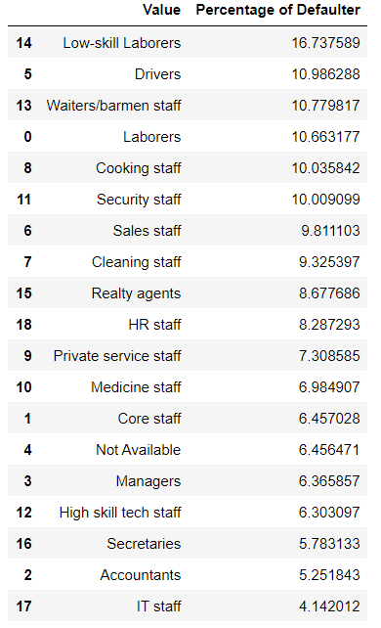
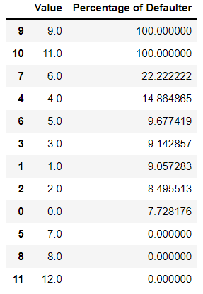
Finding the percentage of Defaulters

Slide 15
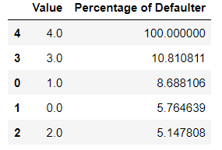
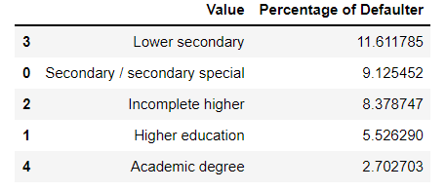
Finding the percentage of Defaulters

Slide 16
Filtration Approach
Unemployed customers are not considered for loan
Low-Skilled laborers and Drivers who defaulted in previous loan
Have Lower Secondary Education and Defaulted previous loan
Pensioners who defaulted in previous loan

Slide 17
Filtration Approach
Income more than 50000
Cash loan applicants who defaulted earlier
Have either Car or House
Mobile Is Reachable

Slide 18
Prescriptive Analysis
Dataset missing values should be enquired
In future loan applications of rejected clients can be considered given they satisfy the eligibility criteria
Bank should ask for atleast one document from loan applicants

Slide 19
Conclusion
Applicant should have a source of income
Should own either car or a house
No previous default record are preferred
Should provide valid contact

Slide 20

Thank You

